Slide 1

BASIC ELECTRICAL AND ELECTRONICS ENGINEERING
Course Code: CSE1002
SCHOOL OF COMPUTER SCIENCE ENGINEERING AND APPLICATIONS
Mrunmayee Rahate
Assistant Professor, DYPIU

Slide 2
Module 3: Bipolar Junction Transistors and MOSFET
Lecture 1: BJT Operation

Slide 3
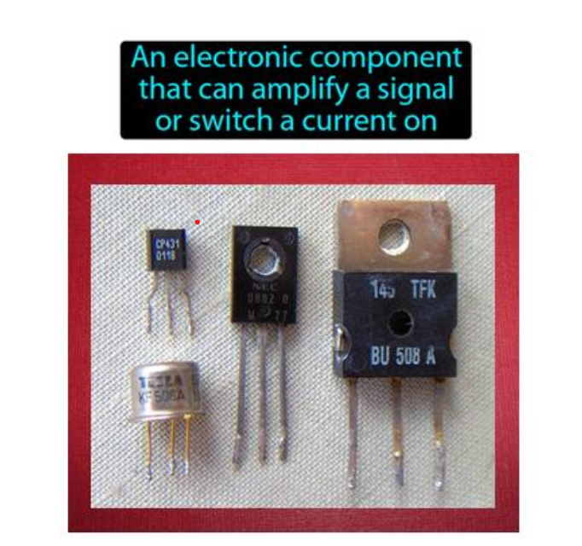
Transistor: definition

Slide 4
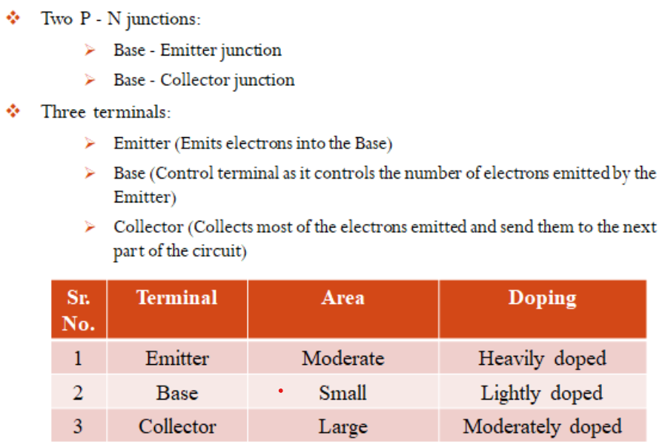
Bipolar Junction Transistor: construction

Slide 5
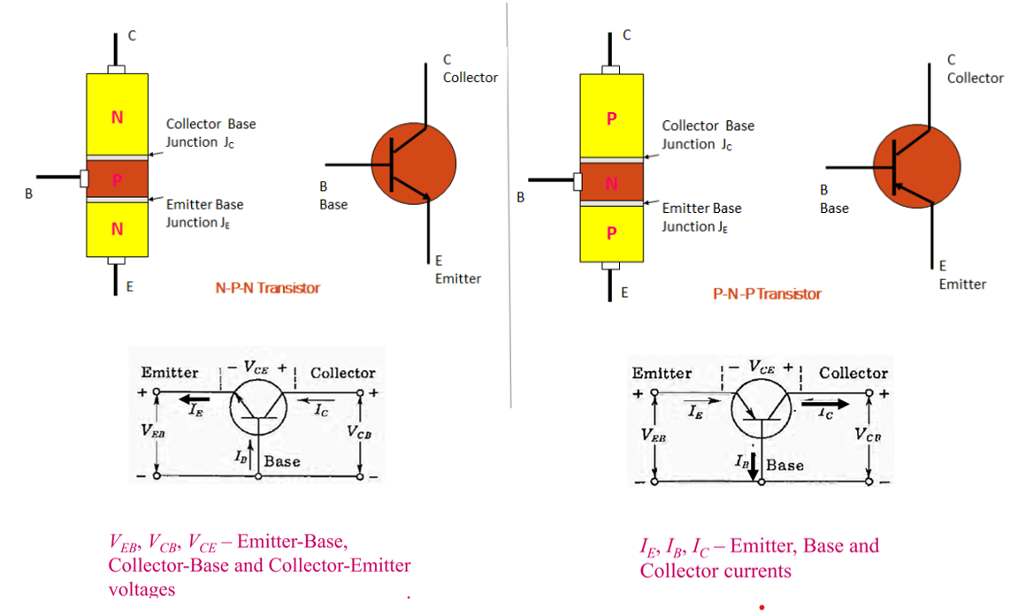
Bipolar Junction Transistor: Types

Slide 6
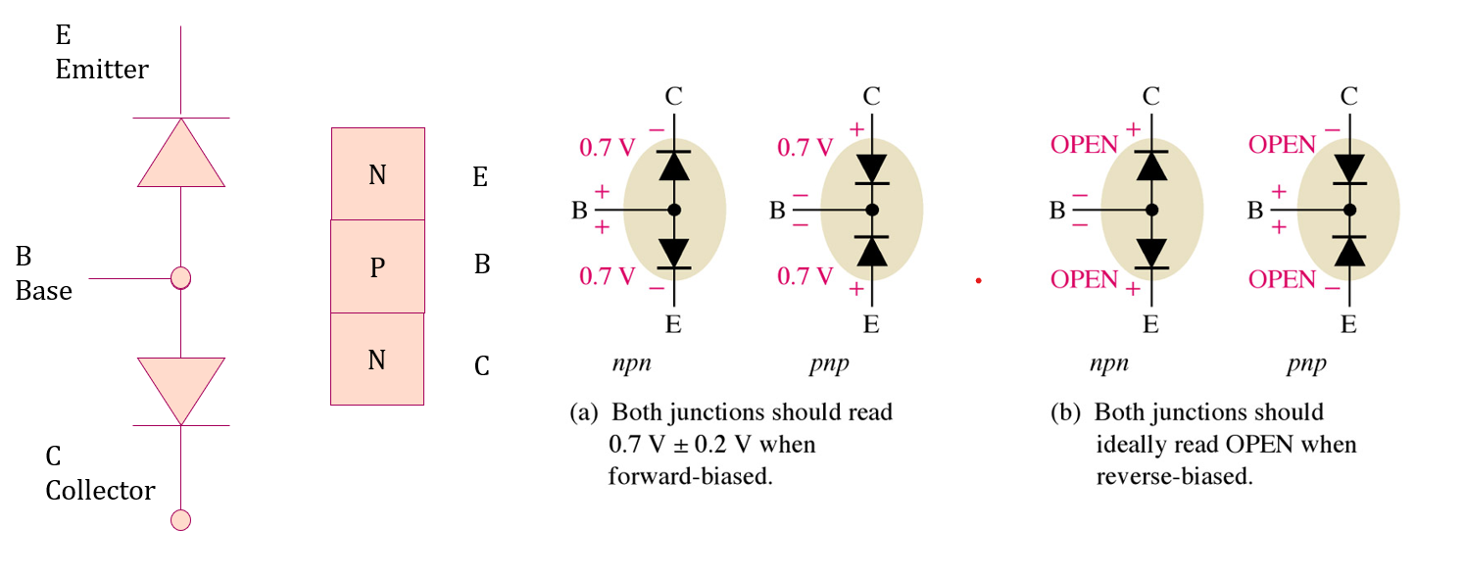
Bipolar Junction Transistor: number of pn junctions and equivalent circuit

Slide 7
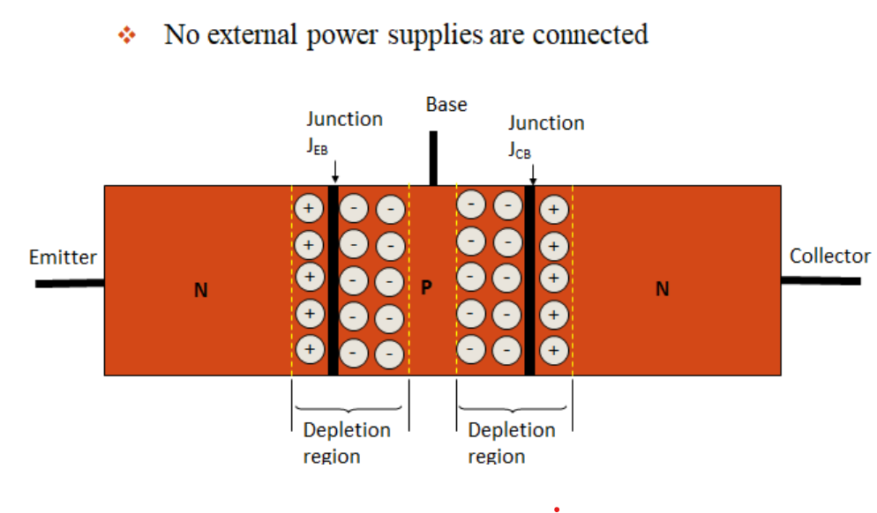
Bipolar Junction Transistor: Unbiased Condition

Slide 8
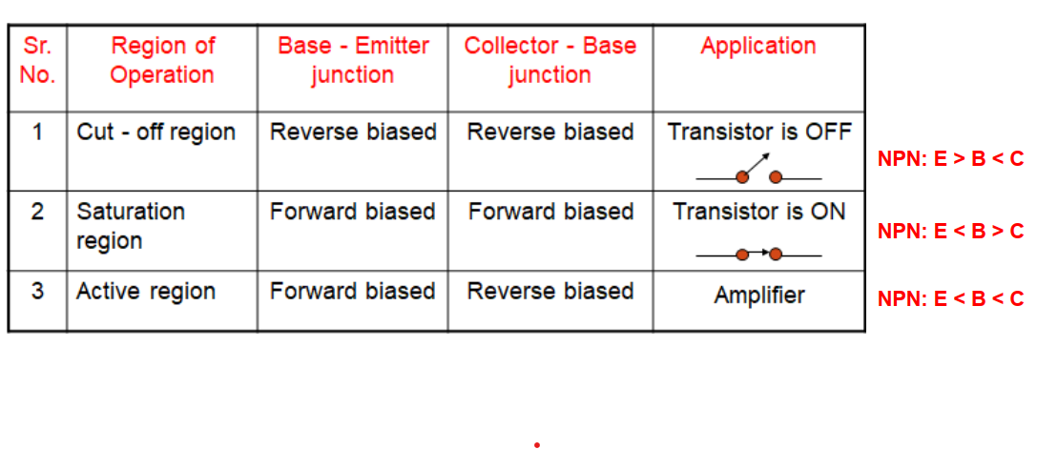
Bipolar Junction Transistor: biasing

Slide 9
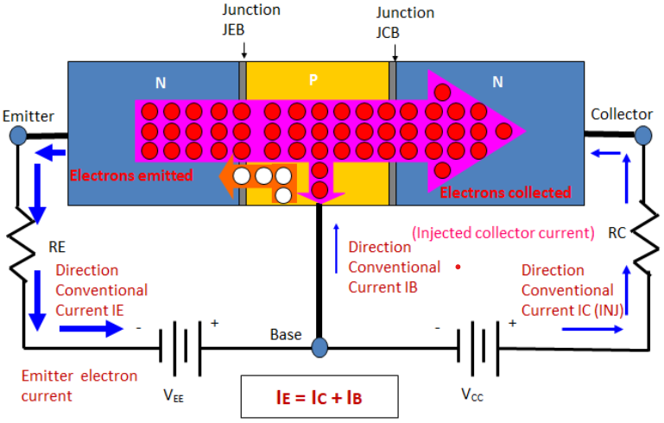
Bipolar Junction Transistor: Operation in Active Region (NPN)

Slide 10
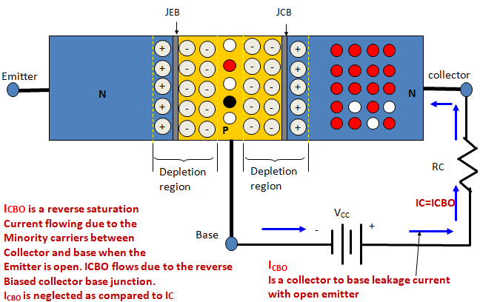
Bipolar Junction Transistor: Operation in Active Region (NPN)

Slide 11
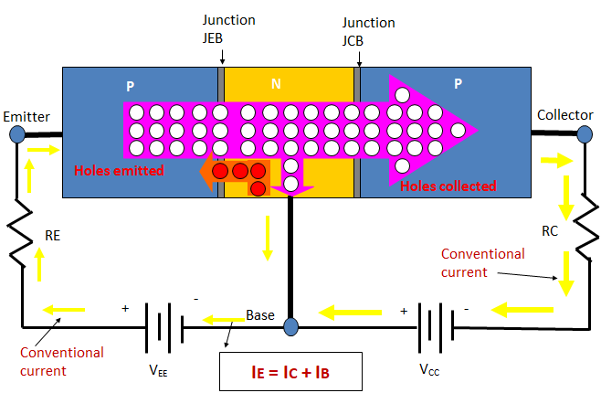
Bipolar Junction Transistor: Operation in Active Region (pnp)

Slide 12
Thank You !!!

